Slide 1
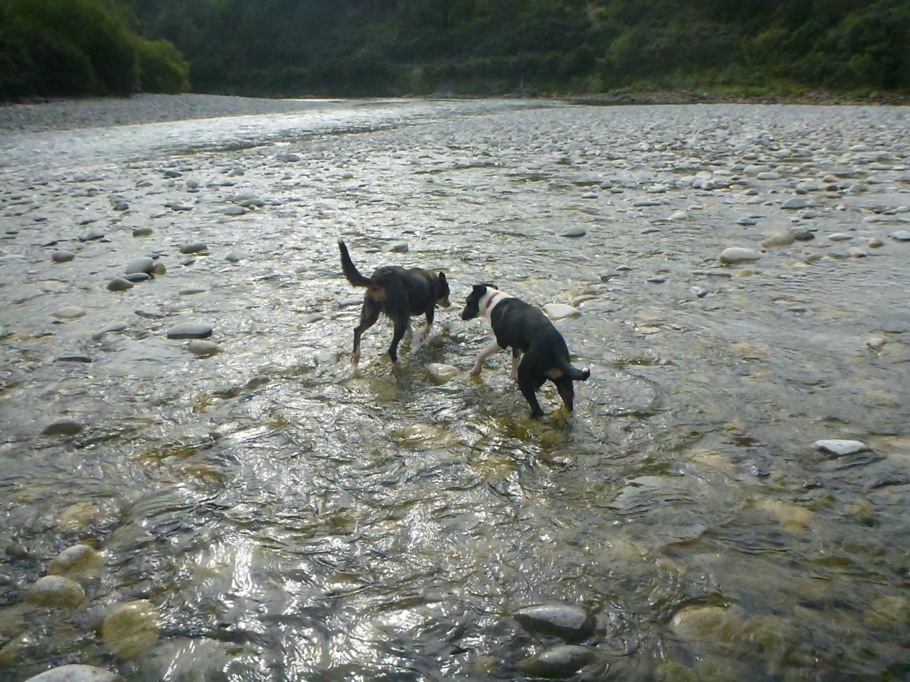
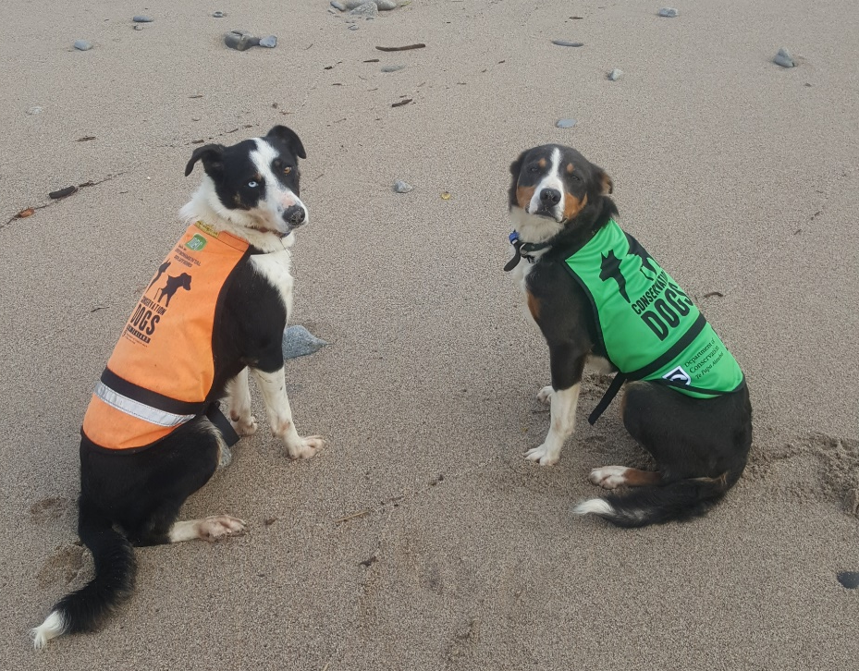
Protective Species Conservation Dogs
Hui 27-28/09/2017
Lynne – with Mica and Pearl

Slide 2
Stats (Mica)
Total Days 1/7/16 – 1/7/17 – 26 full days + many incidental
Species – GSK + Whio
GSK encounters – 18
New GSK – 5
Kiwi searches (presence / absence) – 25
Night Kiwi Listens (Indication only)- 12
Whio – 3

Slide 3
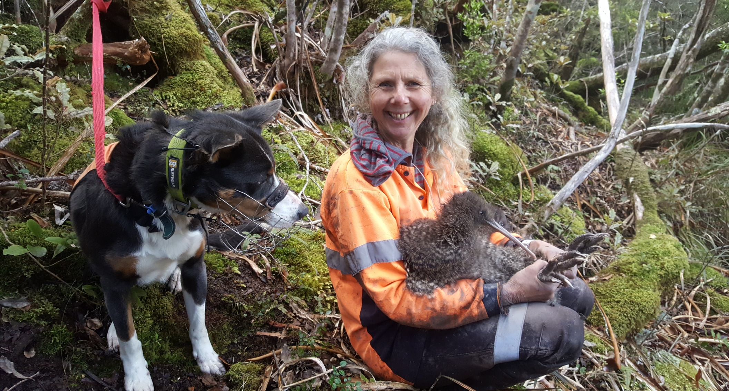
Mica – Kiwi Work – Stockton Mine

Slide 4
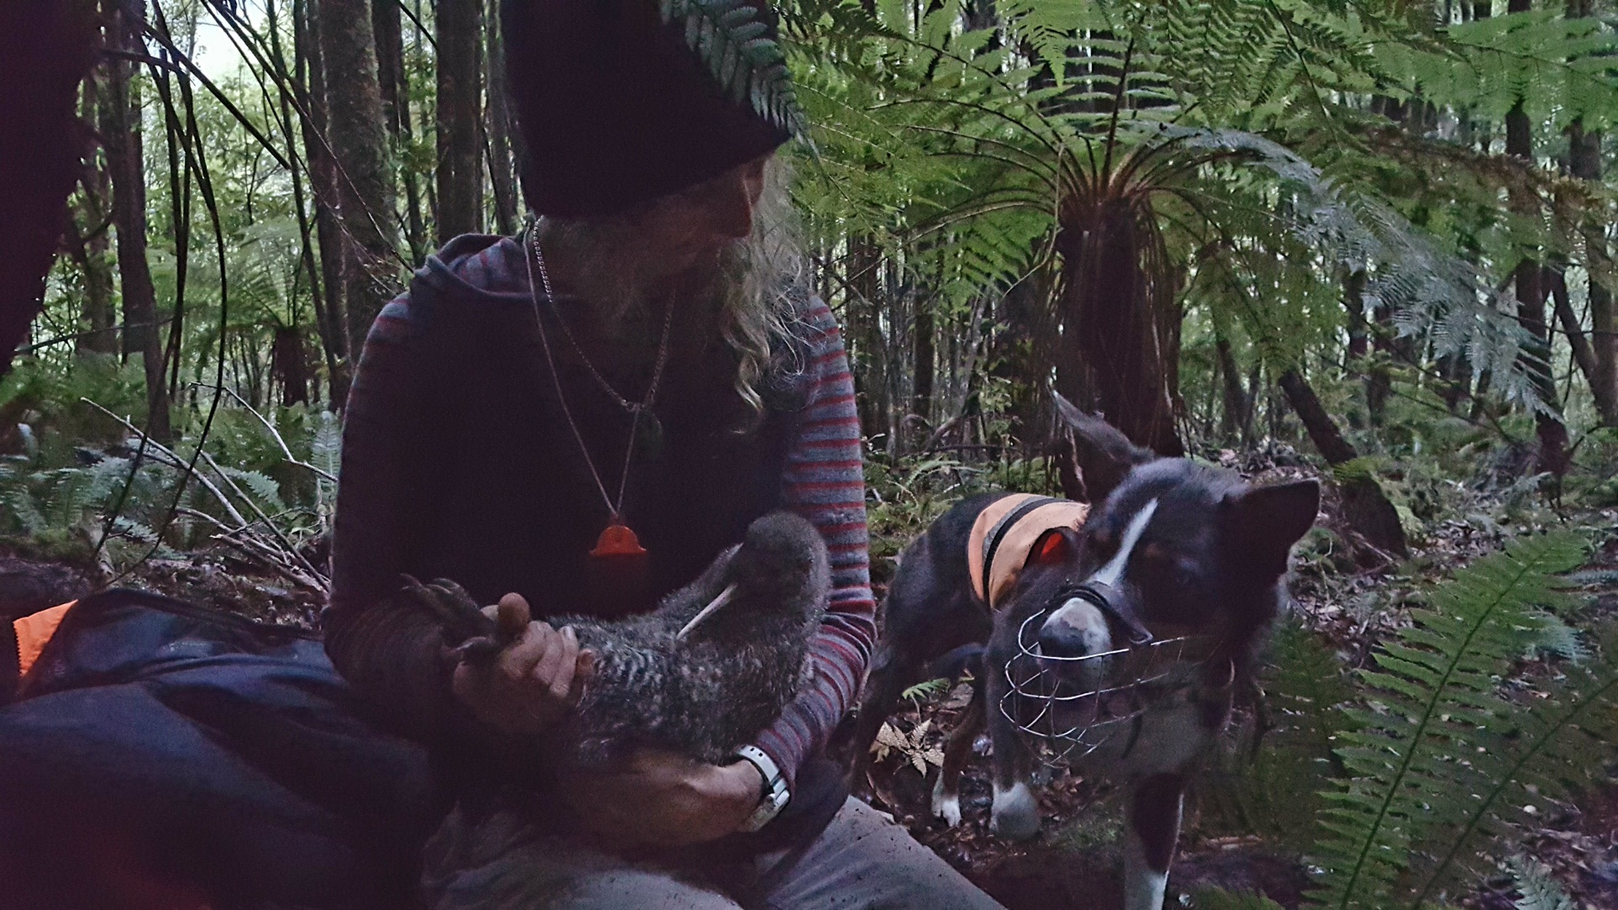
Mica – Kiwi Work – Paparoa Wildlife Trust
Paparoa Ranges

Slide 5
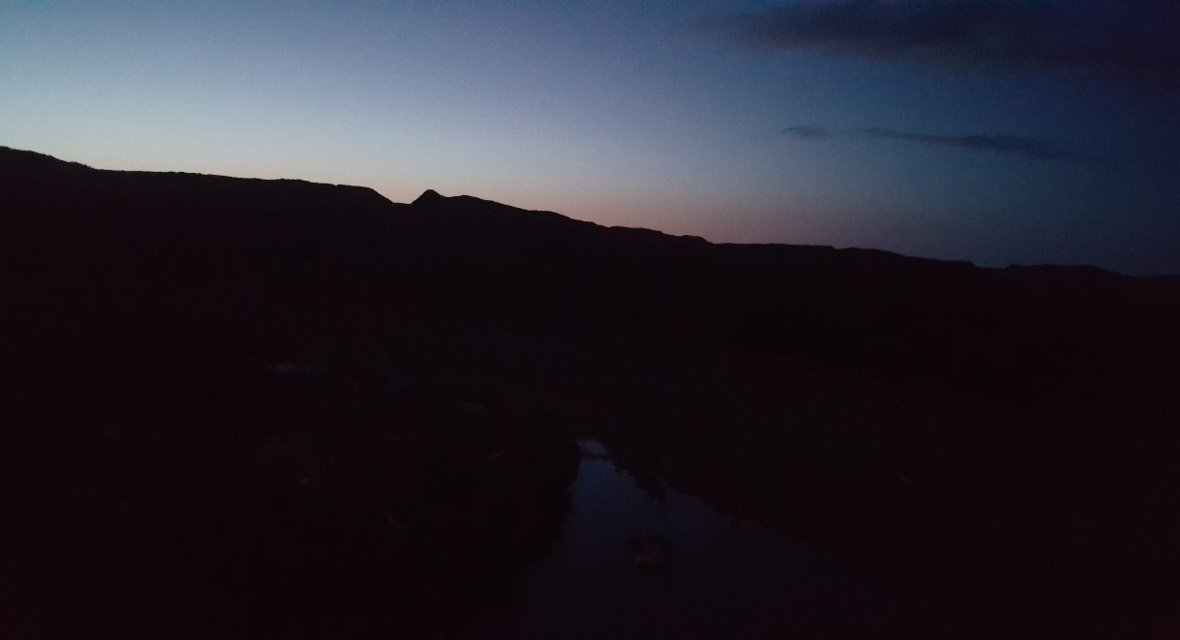
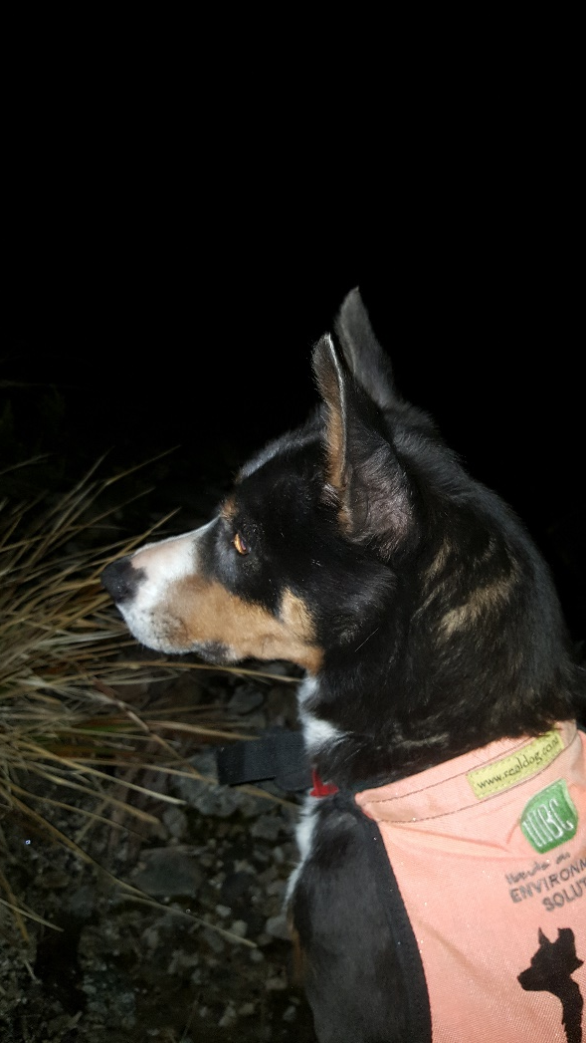
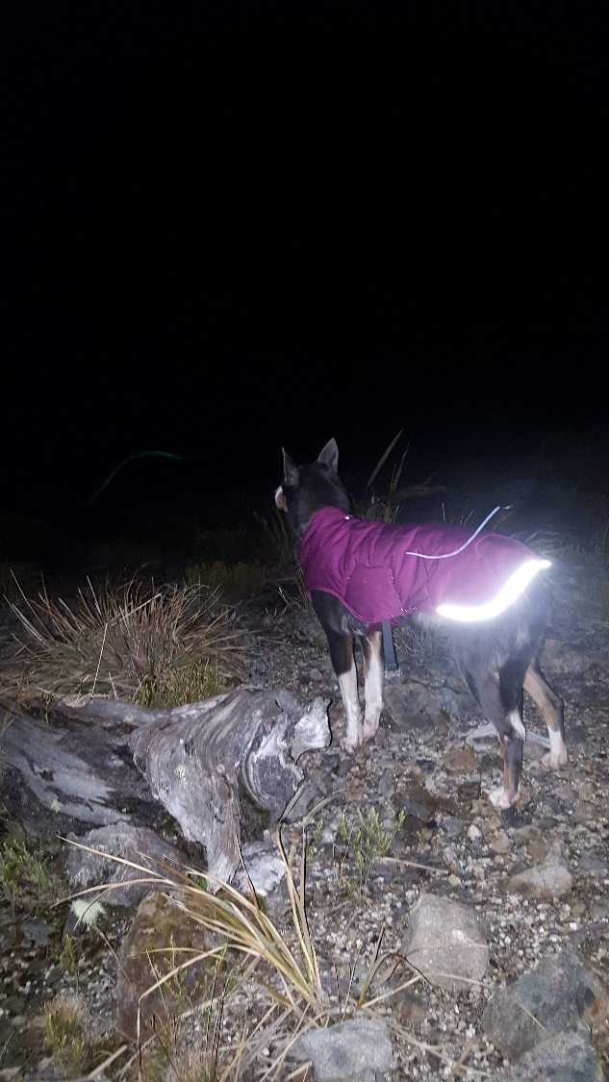
Mica – Kiwi Work – Nocturnal
Stockton Mine

Slide 6
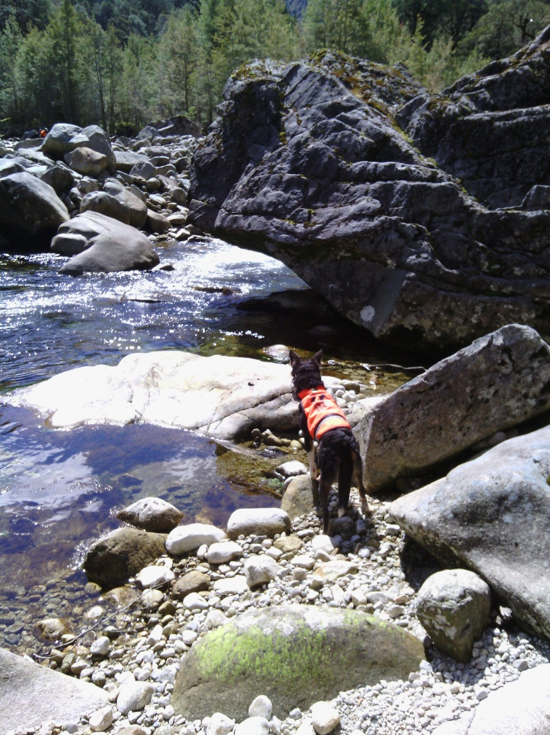
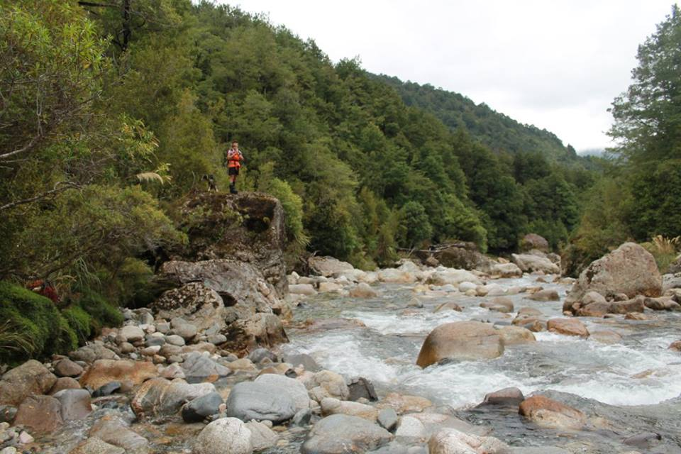
Mica – Whio work – Kahurangi NP
Kakapo River
Ugly River

Slide 7
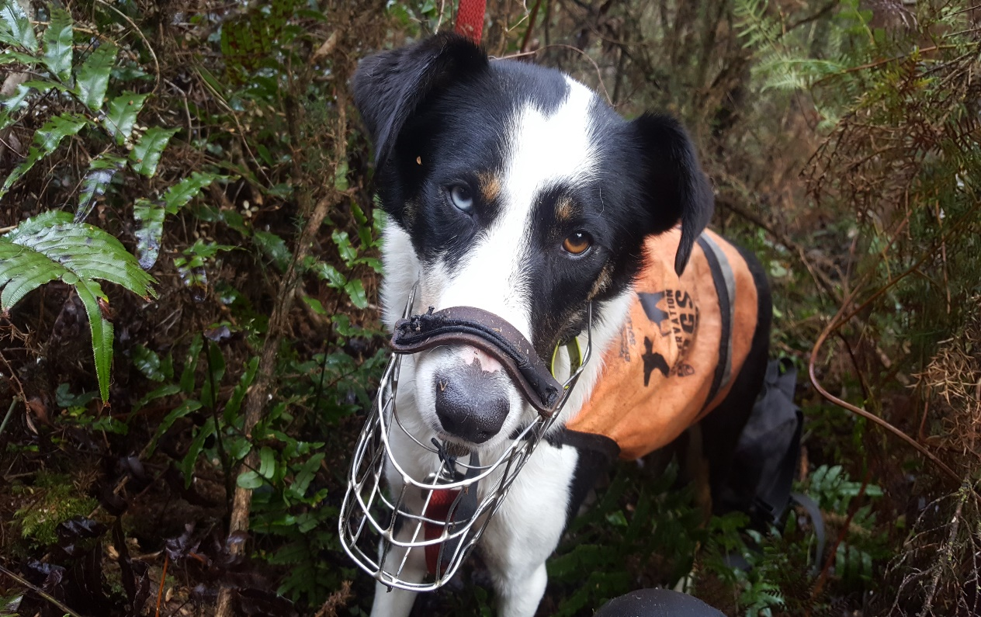
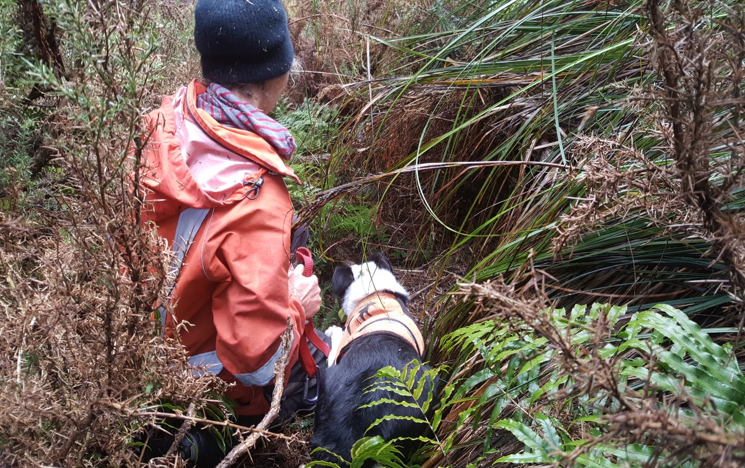
Pearl – Interim – April 2017
Paparoa Ranges

Slide 8
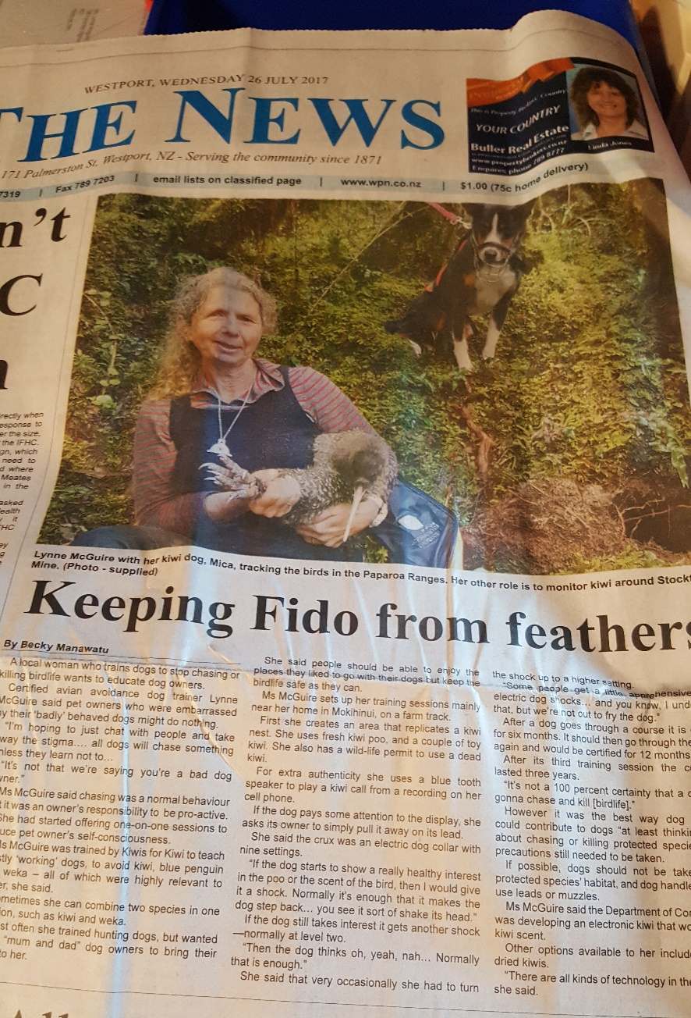
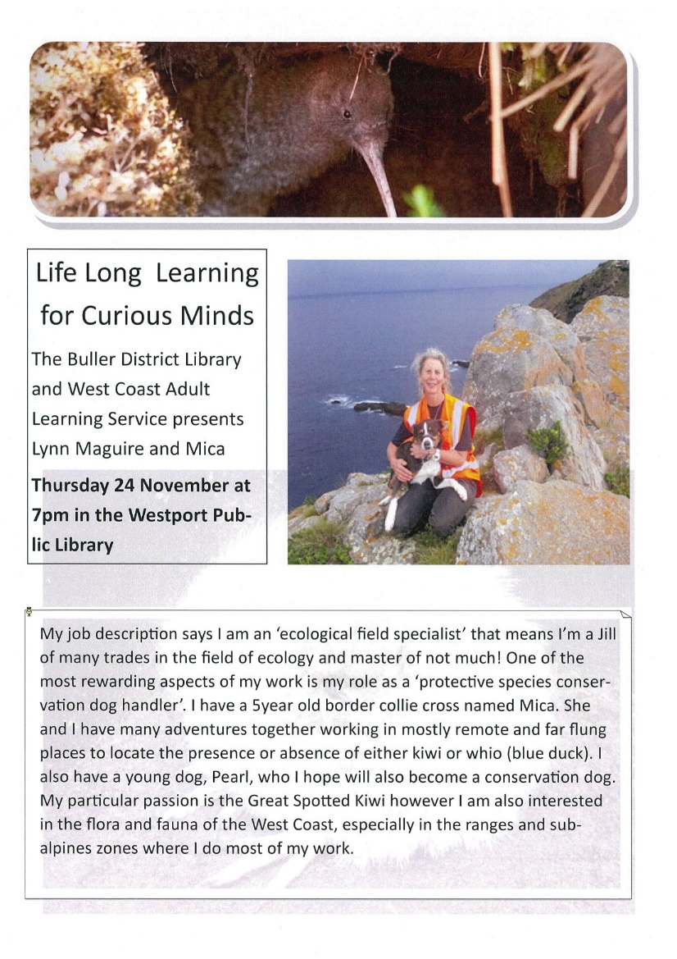
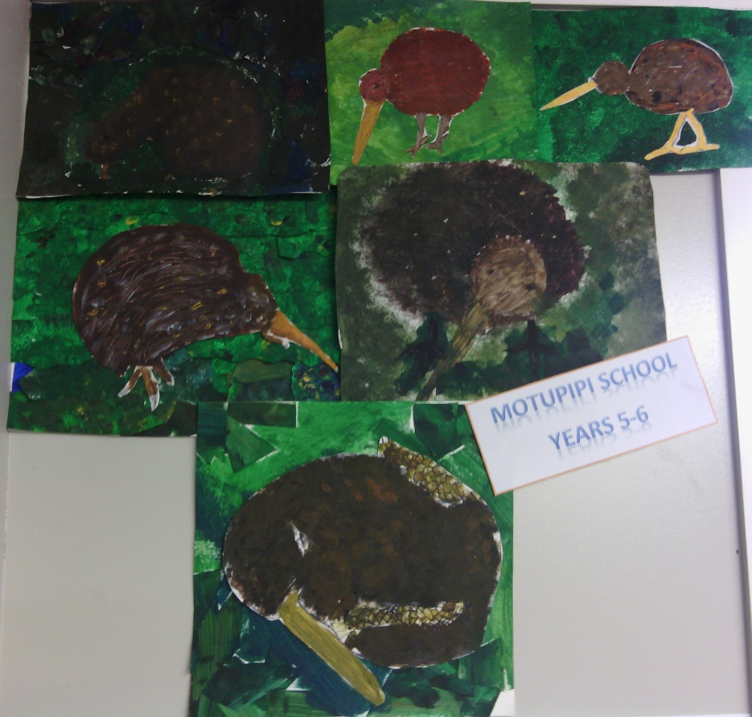
Advocacy

Slide 9
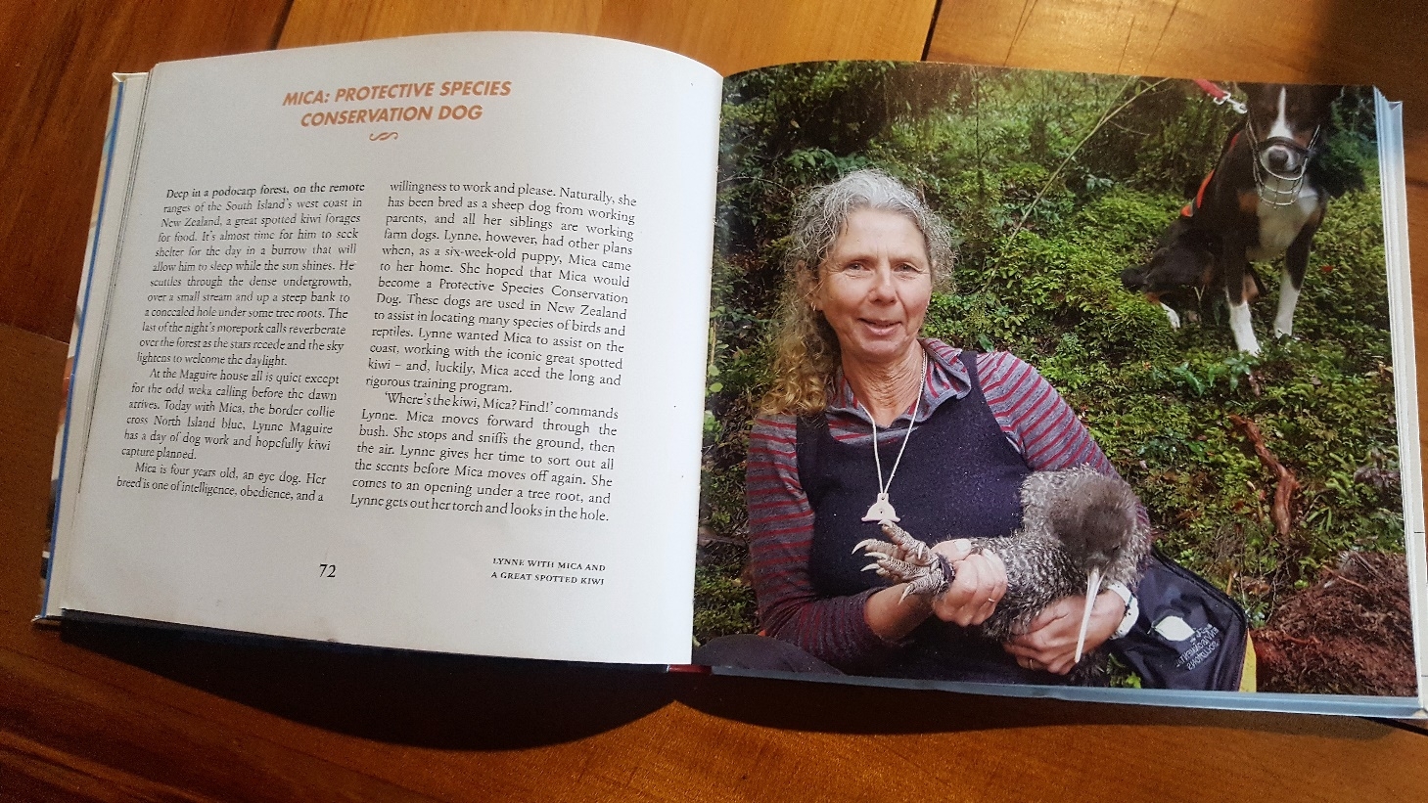
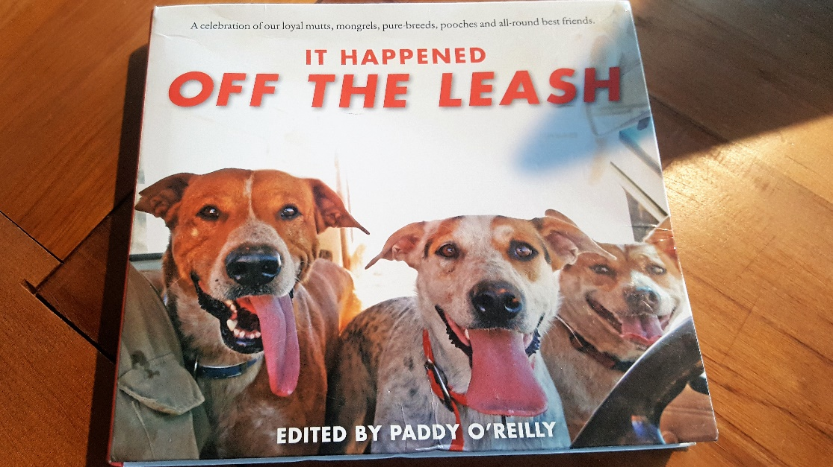
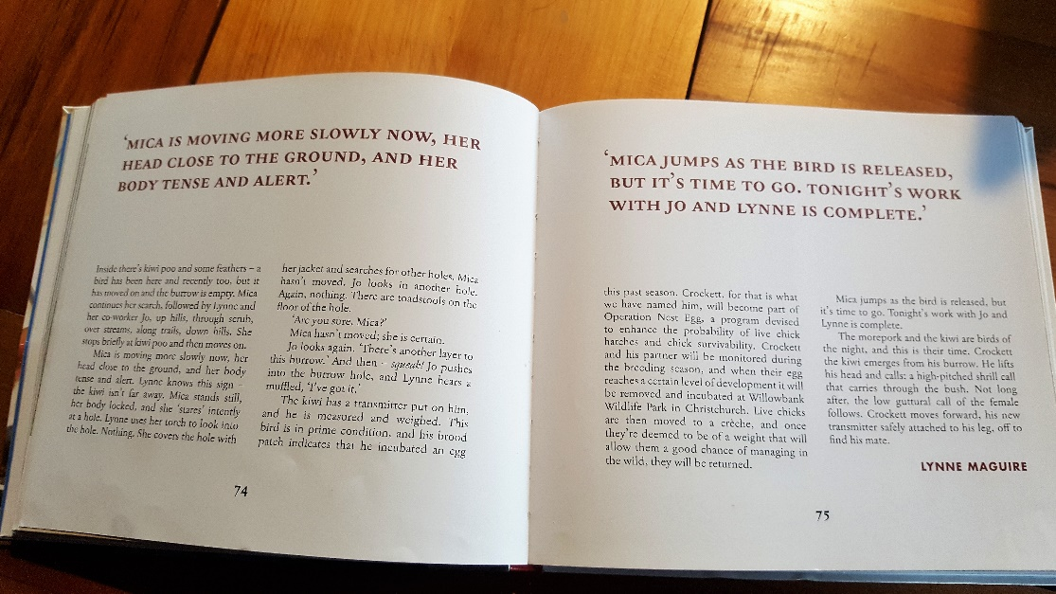
Published!

